Slide 1


SCSA1301-DBMS
SATHYABAMA
INSTITUTE OF SCIENCE AND TECHNOLOGY
UNIT-V
Dr.L.LAKSHMANAN
DEPARTMENT OF COMPUTER SCIENCE AND ENGINEERING

Slide 2
CONCEPTS OF OBJECT DATABASES
1 Overview of O-O Concepts
2 O-O Identity, Object Structure and Type Constructors
3 Encapsulation of Operations, Methods and Persistence
4 Type and Class Hierarchies and Inheritance
5 Complex Objects
6 Other O-O Concepts
7 OODBMS

Slide 3
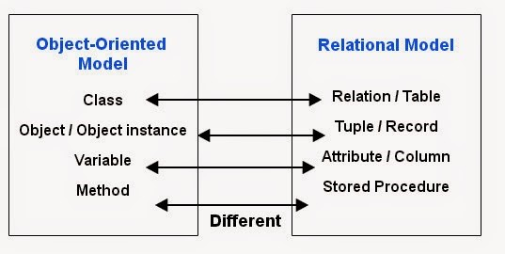
Object Oriented (OO) Data Models since mid-90’s
Reasons for creation of Object Oriented Databases
Need for more complex applications
Need for additional data modeling features
Increased use of object-oriented programming languages
Commercial OO Database products –
Several in the 1990’s, but did not make much impact on main stream data management

Slide 4
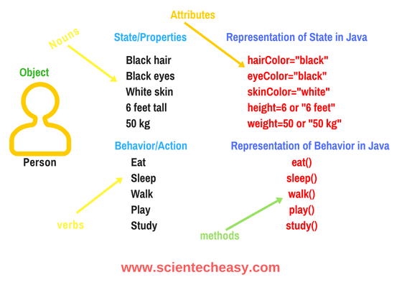
Definition of an object
Objects – User defined complex data types
An object has structure or state (variables) and methods (behavior/operations)
An object is described by four characteristics
Identifier: a system-wide unique id for an object
Name: an object may also have a unique name in DB (optional)
Lifetime: determines if the object is persistent or transient
Structure: Construction of objects using type constructors

Slide 5
Object Identity
Unique Identity:
An OO database system provides a unique identity to each independent object stored in the database.
This unique identity is typically implemented via a unique, system-generated object identifier, or OID
The main property required of an OID is that it be immutable
Specifically, the OID value of a particular object should not change.
This preserves the identity of the real-world object being represented.

Slide 6
Object Structure and Type Constructors
The state (current value) of a complex object may be constructed from other objects (or other values) by using certain type constructors
Can be represented by (i,c,v)
i is an unique id
c is a type constructor
v is the object state
Type Constructors:
In OO databases, the state (current value) of a complex object may be constructed from other objects (or other values) by using certain type constructors.
Basic types: atom, tuple and set
Collection type: list, bag and array

Slide 7
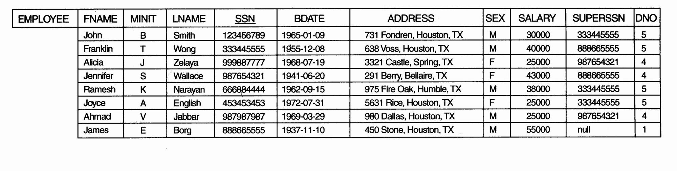
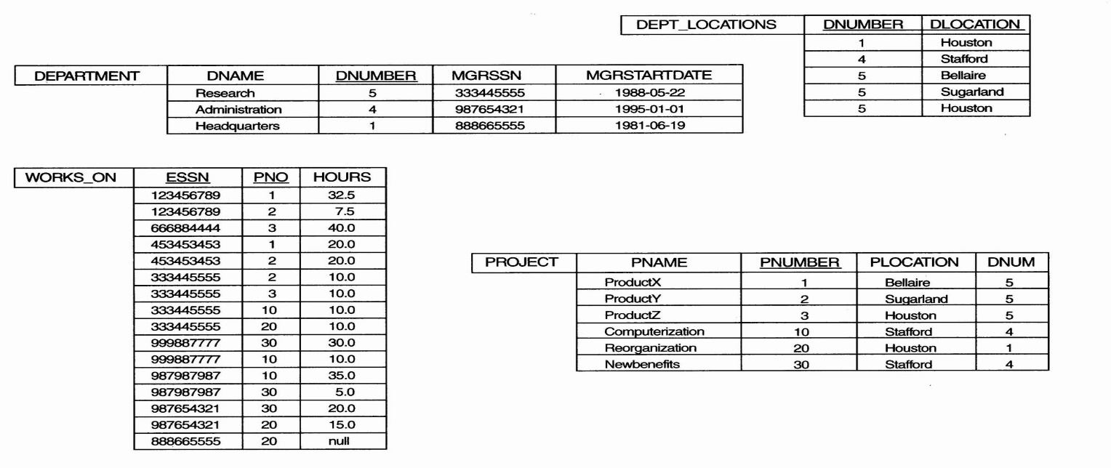
Example
One possible relational database state corresponding to COMPANY schema

Slide 8
Example
We use i₁, i₂, i₃, . . . to stand for unique system-generated object identifiers. Consider the following objects:
o₁ = (i₁, atom, ‘Houston’)
o₂ = (i₂, atom, ‘Bellaire’)
o₃ = (i₃, atom, ‘Sugarland’)
o₄ = (i₄, atom, 5)
o₅ = (i₅, atom, ‘Research’)
o₆ = (i₆, atom, ‘1988-05-22’)
o₇ = (i₇, set, {i1, i2, i3})
o₈ = (i₈, tuple, <dname:i₅, dnumber:i₄, mgr:i₉, locations:i₇, employees:i₁₀, projects:i₁₁>)
o₉ = (i₉, tuple, <manager:i₁2, manager_start_date:i₆>)
o₁₀ = (i₁₀, set, {i₁₂, i₁₃, i₁₄})
o₁₁ = (i₁₁, set {i₁₅, i₁₆, i₁₇})
o₁₂ = (i₁₂, tuple, <fname:i₁₈, minit:i₁₉, lname:i₂₀, ssn:i₂₁, . . ., salary:i₂₆, supervi­sor:i₂₇, dept:i₈>)
The first six objects listed in this example represent atomic values.
Object seven is a set-valued object that represents the set of locations for department 5; the set refers to the atomic objects with values {‘Houston’, ‘Bellaire’, ‘Sugarland’}.
Object 8 is a tuple-valued object that represents department 5 itself, and has the attributes DNAME, DNUMBER, MGR, LOCATIONS, and so on.

Slide 9
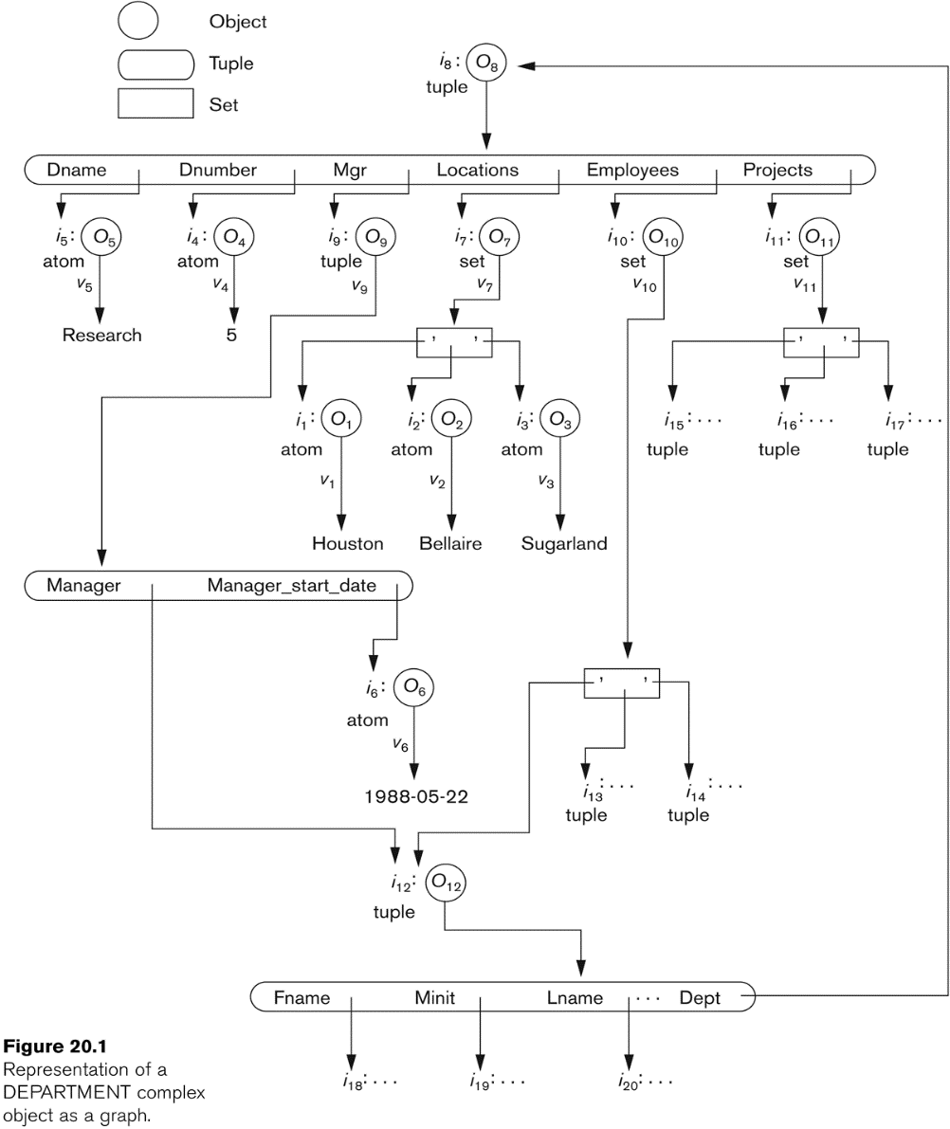
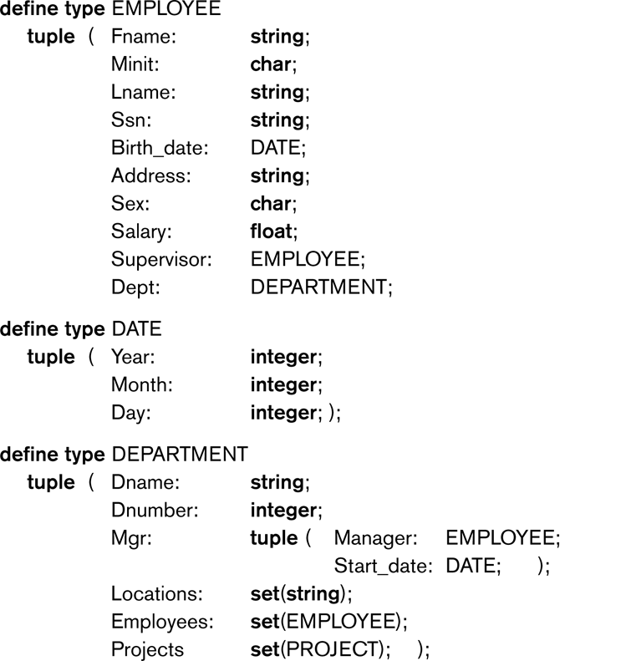
Object Diagram and Type Constructor

Slide 10
Object-Oriented Concepts
Abstract Data Types
Class definition, provides extension to complex attribute types
Encapsulation
Implementation of operations and object structure hidden
Inheritance
Sharing of data within hierarchy scope, supports code reusability
Polymorphism
Operator overloading

Slide 11
Encapsulation of Operations, Methods, and Persistence
Specifying Object Behavior via Class Operations:
The main idea is to define the behavior of a type of object based on the operations that can be externally applied to objects of that type.
In general, the implementation of an operation can be specified in a general-purpose programming language that provides flexibility and power in defining the operations.
For database applications, the requirement that all objects be completely encapsulated is too stringent.

Slide 12
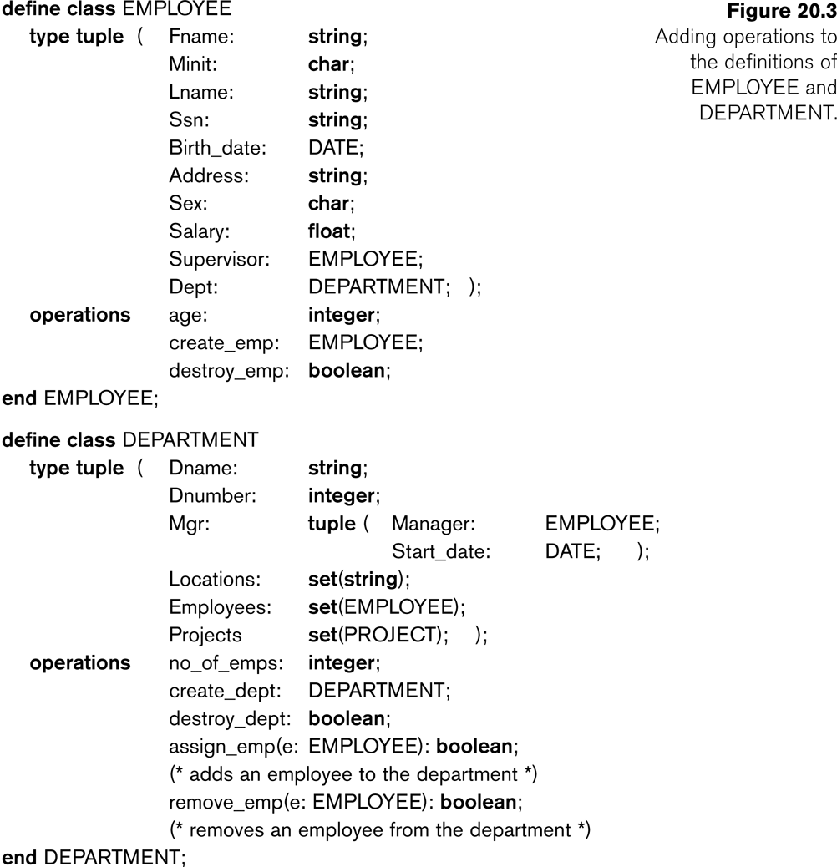

Slide 13
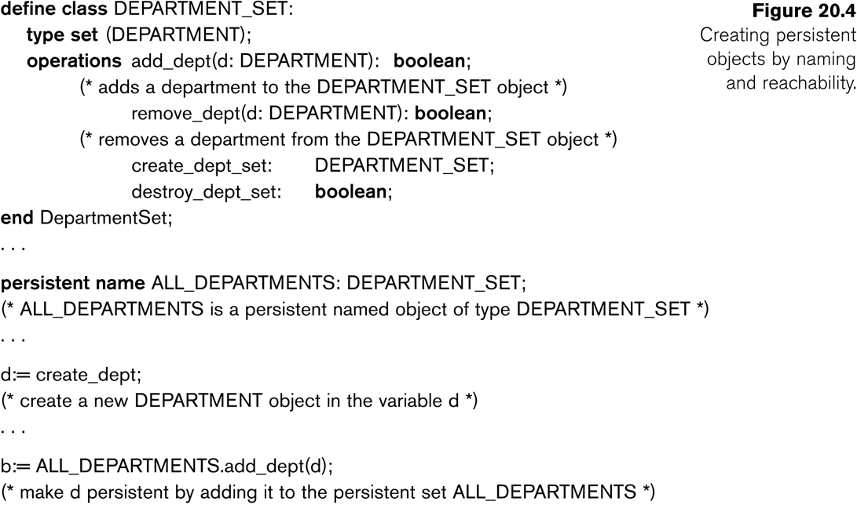
Specifying Object Persistence via Naming and Reachability:
Naming Mechanism:
Assign an object a unique persistent name through which it can be retrieved by this and other programs.
Reachability Mechanism:
Make the object reachable from some persistent object.
An object B is said to be reachable from an object A if a sequence of references in the object graph lead from object A to object B.

Slide 14
Type and Class Hierarchies and Inheritance
Type (class) Hierarchy
A type in its simplest form can be defined by giving it a type name and then listing the names of its visible (public) functions
When specifying a type in this section, we use the following format, which does not specify arguments of functions, to simplify the discussion:
TYPE_NAME: function, function, . . . , function
Example:
PERSON: Name, Address, Birthdate, Age, SSN
Subtype:
When the designer or user must create a new type that is similar but not identical to an already defined type
Supertype:
It inherits all the functions of the subtype

Slide 15
Example (1):
PERSON: Name, Address, Birthdate, Age, P-ID
EMPLOYEE: Name, Address, Birthdate, Age, P-ID, Salary, HireDate, Seniority
STUDENT: Name, Address, Birthdate, Age, P-ID, Major, GPA
OR:
EMPLOYEE subtype-of PERSON: Salary, HireDate, Seniority
STUDENT subtype-of PERSON: Major, GPA

Slide 16
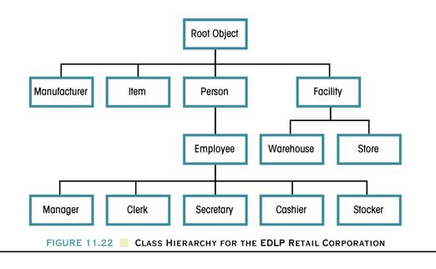
Class Hierarchy For The EDLP Retail Corporation

Slide 17
Type and Class Hierarchies and Inheritance
Extents:
In most OO databases, the collection of objects in an extent has the same type or class.
However, since the majority of OO databases support types, we assume that extents are collections of objects of the same type for the remainder of this section.
Persistent Collection:
This holds a collection of objects that is stored permanently in the database and hence can be accessed and shared by multiple programs
Transient Collection:
This exists temporarily during the execution of a program but is not kept when the program terminates

Slide 18
Other Objected-Oriented Concepts
Polymorphism (Operator Overloading):
This concept allows the same operator name or symbol to be bound to two or more different implementations of the operator, depending on the type of objects to which the operator is applied
For example + can be:
Addition in integers
Concatenation in strings (of characters)

Slide 19
Complex Objects
Unstructured complex object:
These is provided by a DBMS and permits the storage and retrieval of large objects that are needed by the database application.
Typical examples of such objects are bitmap images and long text strings (such as documents); they are also known as binary large objects, or BLOBs for short.
This has been the standard way by which Relational DBMSs have dealt with supporting complex objects, leaving the operations on those objects outside the RDBMS.

Slide 20
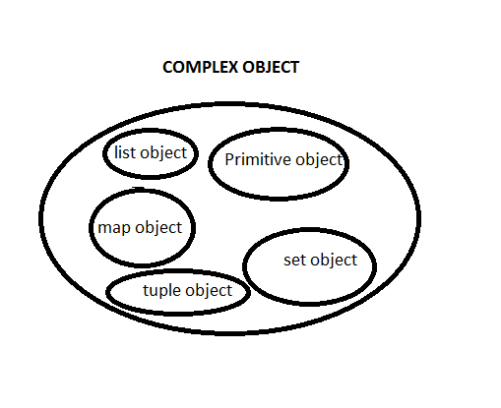
Complex Objects
Structured complex object:
This differs from an unstructured complex object in that the object’s structure is defined by repeated application of the type constructors provided by the OODBMS.
Hence, the object structure is defined and known to the OODBMS.
The OODBMS also defines methods or operations on it.

Slide 21
What is Object Oriented Database? (OODB)
A database system that incorporates all the important object-oriented concepts
Some additional features
Unique Object identifiers
Persistent object handling

Slide 22
Advantages of OODBS
Designer can specify the structure of objects and their behavior (methods)
Better interaction with object-oriented languages such as Java and C++
Definition of complex and user-defined types
Encapsulation of operations and user-defined methods

Slide 23
Disadvantages of OODBS
Lack of theoretical foundation.
Lack of standard ad hoc query language.
Lack of business data design and management tools.
Lack of resources.

Slide 24
Object Query Language (OQL)
Declarative query language
Not computationally complete
Syntax based on SQL (select, from, where)
Additional flexibility (queries with user defined operators and types)
The following is a sample query
“what are the names of the black product?”
Select distinct p.name
From products p
Where p.color = “black”
Valid in both SQL and OQL, but results are different.

Slide 25
Result of the query
Product no | Name | Color
P1 | Ford Mustang | Black
P2 | Toyota Celica | Green
P3 | Mercedes SLK | Black
Original table
Result-SQL
Name
Ford Mustang Mercedes SLK
- The statement queries a relational database.
=> Returns a table with rows.
Result-OQL
String
Ford Mustang
String
Mercedes SLK
- The statement queries a object-oriented database
=> Returns a collection of objects.

Slide 26
Comparison
Queries look very similar in SQL and OQL, sometimes they are the same
In fact, the results they give are very different
Query returns:
OQL | SQL
Object Collection of objects | Tuple Table

Slide 27
SQL3 “Object-oriented SQL”
Foundation for several OO database management systems – ORACLE8, DB2, etc
New features – “relational” & “Object oriented”
Relational Features – new data types, new predicates, enhanced semantics, additional security and an active database
Object Oriented Features – support for functions and procedures

Slide 28
Emerging Database Technologies and Application
1 Mobile Databases
2 Multimedia Databases
3 Geographic Information Systems
4 GENOME Data Management

Slide 29
Mobile Databases
Recent advances in portable and wireless technology led to mobile computing, a new dimension in data communication and processing.
Portable computing devices coupled with wireless communications allow clients to access data from virtually anywhere and at any time.
There are a number of hardware and software problems that must be resolved before the capabilities of mobile computing can be fully utilized.
Some of the software problems – which may involve data management, transaction management, and database recovery – have their origins in distributed database systems.

Slide 30
Mobile Databases
In mobile computing, the problems are more difficult, mainly:
The limited and intermittent connectivity afforded by wireless communications.
The limited life of the power supply(battery).
The changing topology of the network.
In addition, mobile computing introduces new architectural possibilities and challenges.

Slide 31
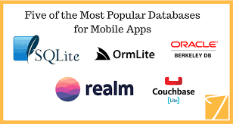

Slide 32
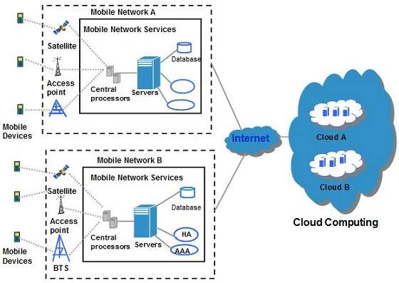
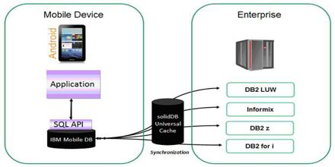
Mobile Computing Architecture

Slide 33
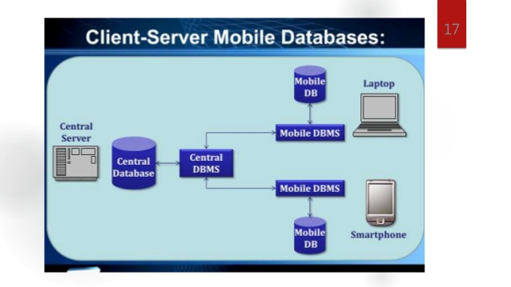
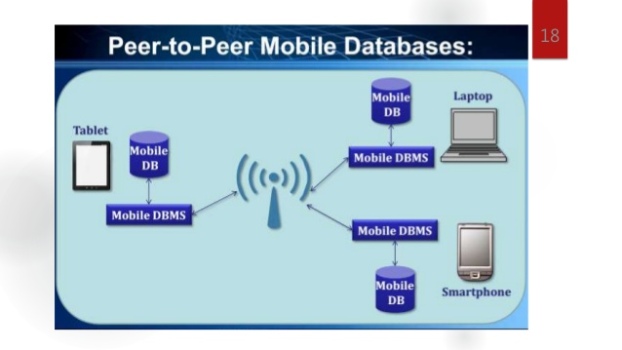
Mobile Database Architecture-types

Slide 34
Data Management Issues
From a data management standpoint, mobile computing may be considered a variation of distributed computing. Mobile databases can be distributed under two possible scenarios:
The entire database is distributed mainly among the wired components, possibly with full or partial replication.
A base station or fixed host manages its own database with a DBMS-like functionality, with additional functionality for locating mobile units and additional query and transaction management features to meet the requirements of mobile environments.
The database is distributed among wired and wireless components.
Data management responsibility is shared among base stations or fixed hosts and mobile units.

Slide 35
Data Management Issues
Data management issues as it is applied to mobile databases:
Data distribution and replication
Transactions models
Query processing
Recovery and fault tolerance
Mobile database design
Location-based service
Division of labor
Security

Slide 36
Application-Mobile Database
Whenever clients connect – through a process known in industry as synchronization of a client with a server – they receive a batch of updates to be installed on their local database.
The primary characteristic of this scenario is that the clients are mostly disconnected; the server is not necessarily able reach them.
This environment has problems similar to those in distributed and client-server databases, and some from mobile databases.
This environment is referred to as Intermittently Synchronized Database Environment (ISDBE).
Intermittently Synchronized Databases (ISDBs)
A client connects to the server when it wants to exchange updates.
A server cannot connect to a client at will.

Slide 37
Multimedia Databases
DBMSs have been constantly adding to the types of data they support.
Today many types of multimedia data are available in current systems.
Text: May be formatted or unformatted. For ease of parsing structured documents, standards like SGML and variations such as HTML
Graphics: Examples include drawings and illustrations that are encoded using some descriptive standards (e.g. CGM, PICT, postscript).
Images: Includes drawings, photographs, and so forth, encoded in standard formats such as bitmap, JPEG, and MPEG. Compression is built into JPEG and MPEG.
Animations: Temporal sequences of image or graphic data.
Video: A set of temporally sequenced photographic data for presentation at specified rates– for example, 30 frames per second.
Structured audio: A sequence of audio components comprising note, tone, duration, and so forth.
Audio: Sample data generated from aural recordings in a string of bits in digitized form. Analog recordings are typically converted into digital form before storage.

Slide 38

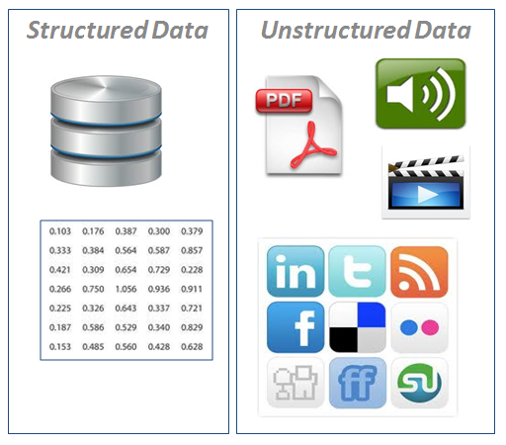

Slide 39
Multimedia Databases
Applications based on their data management characteristics:
Repository applications: A large amount of multimedia data as well as metadata is stored for retrieval purposes. Examples include repositories of satellite images, engineering drawings and designs, space photographs, and radiology scanned pictures.
Presentation applications: A large amount of applications involve delivery of multimedia data subject to temporal constraints; simple multimedia viewing of video data, for example, requires a system to simulate VCR-like functionality.
Collaborative work using multimedia information: This is a new category of applications in which engineers may execute a complex design task by merging drawings, fitting subjects to design constraints, and generating new documentation, change notifications, and so forth. Intelligent healthcare networks as well as telemedicine will involve doctors collaborating among themselves, analyzing multimedia patient data and information in real time as it is generated.

Slide 40
Data Management Issues
Multimedia information systems are very complex and embrace a large set of issues:
Modeling
Complex objects
Design
Conceptual, logical, and physical design of multimedia has not been addressed fully.
Storage
Multimedia data on standard disklike devices presents problems of representation, compression, mapping to device hierarchies, archiving, and buffering during the input/output operation.
Queries and retrieval
“Database” way of retrieving information is based on query languages and internal index structures.
Performance
Multimedia applications involving only documents and text, performance constraints are subjectively determined by the user.

Slide 41
Multimedia Database Applications
Large-scale applications of multimedia databases can be expected encompasses a large number of disciplines and enhance existing capabilities.
Documents and records management
Knowledge dissemination
Education and training
Marketing, advertising, retailing, entertainment, and travel
Real-time control and monitoring

Slide 42
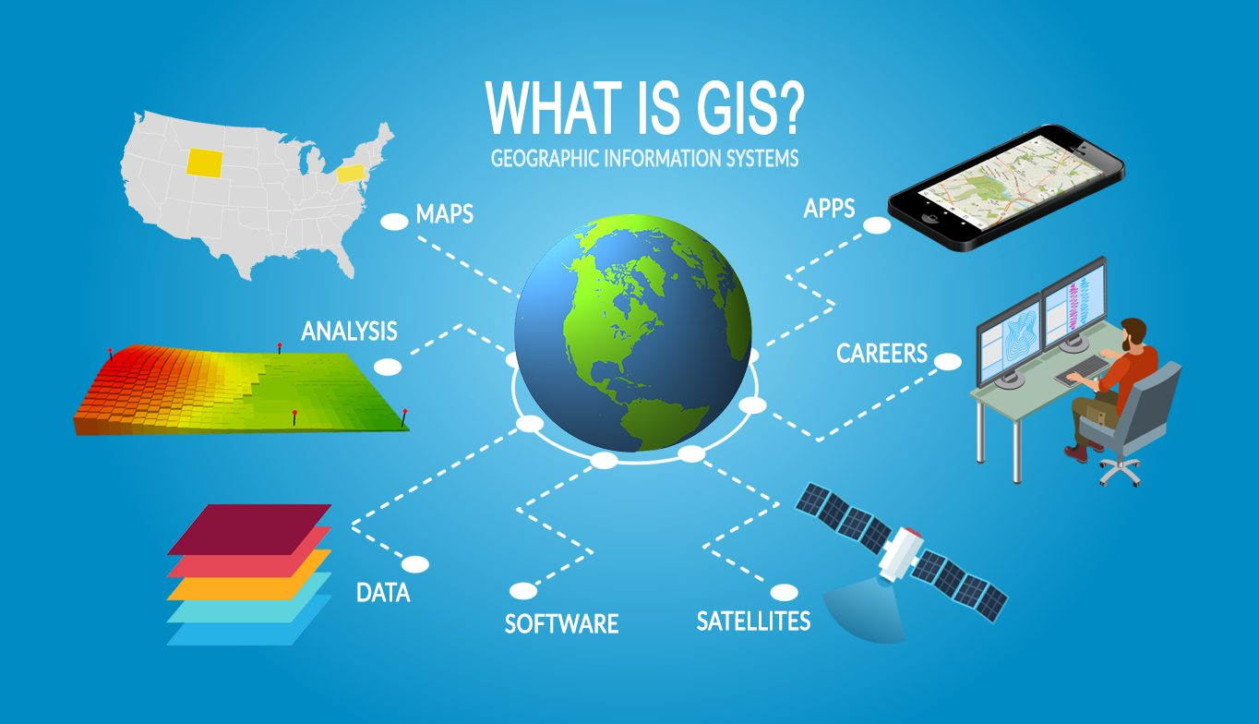
Geographic Information Systems
Geographic information systems(GIS) are used to collect, model, and analyze information describing physical properties of the geographical world.

Slide 43
Geographic Information Systems
The scope of GIS broadly encompasses two types of data:
Spatial data, originating from maps, digital images, administrative and political boundaries, roads, transportation networks, physical data, such as rivers, soil characteristics, climatic regions, land elevations, and
Non-spatial data, such as socio-economic data (like census counts), economic data, and sales or marketing information. GIS is a rapidly developing domain that offers highly innovative approaches to meet some challenging technical demands.

Slide 44
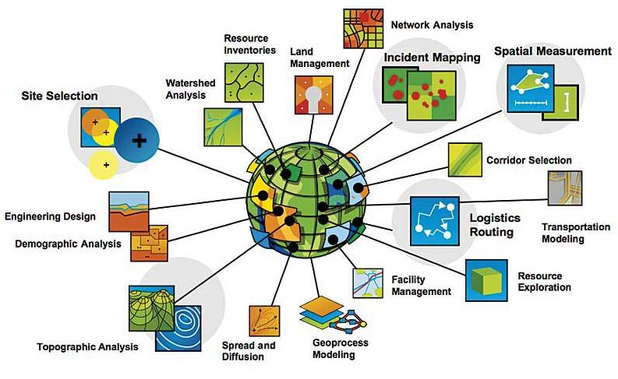
GIS Applications

Slide 45
Data Management Requirements of GIS
Data Analysis
GIS data undergoes various types of analysis.
For example, in applications
such as soil erosion studies, environmental impact studies, or hydrological runoff simulations,
DTM data may undergo various types of geomorphometric analysis – measurements such as
slope values, gradients (the rate of change in altitude), aspect (the compass direction of the gradient), profile convexity (the rate of change of gradient), plan convexity (the convexity of contours and other parameters).

Slide 46
Data Management Requirements of GIS
Data Integration
GISs must integrate both vector and raster data from a variety of sources.
Sometimes edges and regions are inferred from a raster image to form a vector model, or conversely, raster images such as aerial photographs are used to update vector models.
Several coordinate systems such as Universal Transverse Mercator (UTM), latitude/longitude, and local cadastral systems are used to identify locations.
Data originating from different coordinate systems requires appropriate transformations.

Slide 47
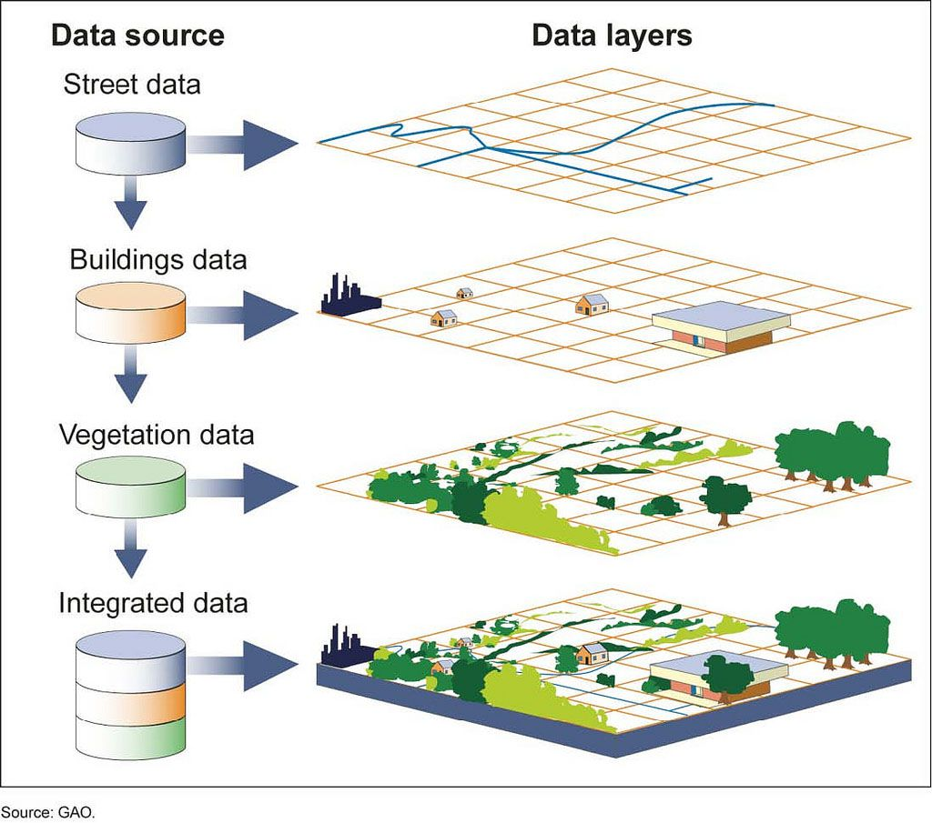

Slide 48
Data Management Requirements of GIS
Data Capture
The first step in developing a spatial database for cartographic modeling is
to capture the two-dimensional or three-dimensional geographical information in digital form
This process that is sometimes impeded by source map characteristics such as resolution, type of projection, map scales, cartographic licensing, diversity of measurement techniques, and coordinate system differences.
Spatial data can also be captured from remote sensors in satellites such as Landsat, NORA, and Advanced Very High Resolution Radiometer(AVHRR) as well as SPOT HRV (High Resolution Visible Range Instrument.

Slide 49
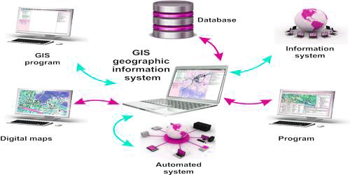

Slide 50
Specific GIS Data Operations
The functionality of a GIS database is also subject to other considerations:
Extensibility
Data quality control
Visualization
Such requirements clearly illustrate that standard RDBMSs or ODBMSs do not meet the special needs of GIS.
Therefore it is necessary to design systems that support the vector and raster representations and the spatial functionality as well as the required DBMS features.
Vector data represents geometric objects such as points, lines, and polygons.
Raster data is characterized as an array of points, where each point represents the value of an attribute for a real-world location.

Slide 51
Genome Data Management
Biological Sciences and Genetics:
The biological sciences encompass an enormous variety of information.
Environmental science gives us a view of how species live and interact in a world filled with natural phenomena.
Biology and ecology study particular species.
Anatomy focuses on the overall structure of an organism, documenting the physical aspects of individual bodies.
Traditional medicine and physiology break the organism into systems and tissues and strive to collect information on the workings of these systems and the organism as a whole.

Slide 52
The Genome Database (GDB)
More recently efforts have been made to add data on mutations linked to genetic loci, cell lines used in experiments, DNA probe libraries, and some limited polymorphism and population data.
The GDB system is built around Sybase, a commercial relational DBMS, and its data are modeled using standard Entity-Relationship techniques.
GDB distributes a Database Access Toolkit

Slide 53
The Genome Database (GDB) As with GenBank, users are given only a very high-level view of the data at the time of searching and thus cannot make use of any knowledge gleaned from the structure of the GDB tables.
Search methods are most useful when users are simply looking for an index into map or probe data.
Exploratory ad hoc searching is not encouraged by present interfaces.

Slide 54
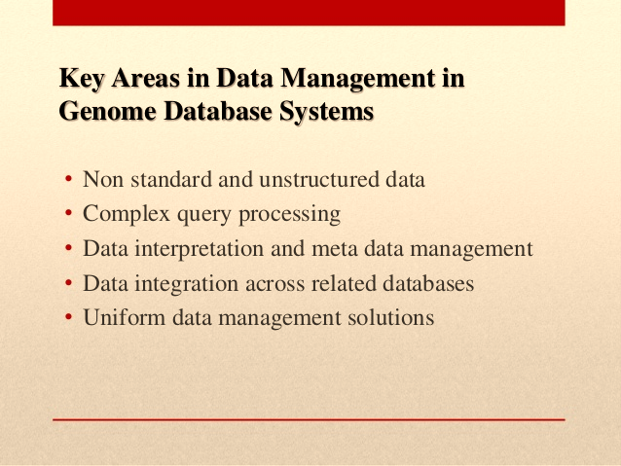

Slide 55
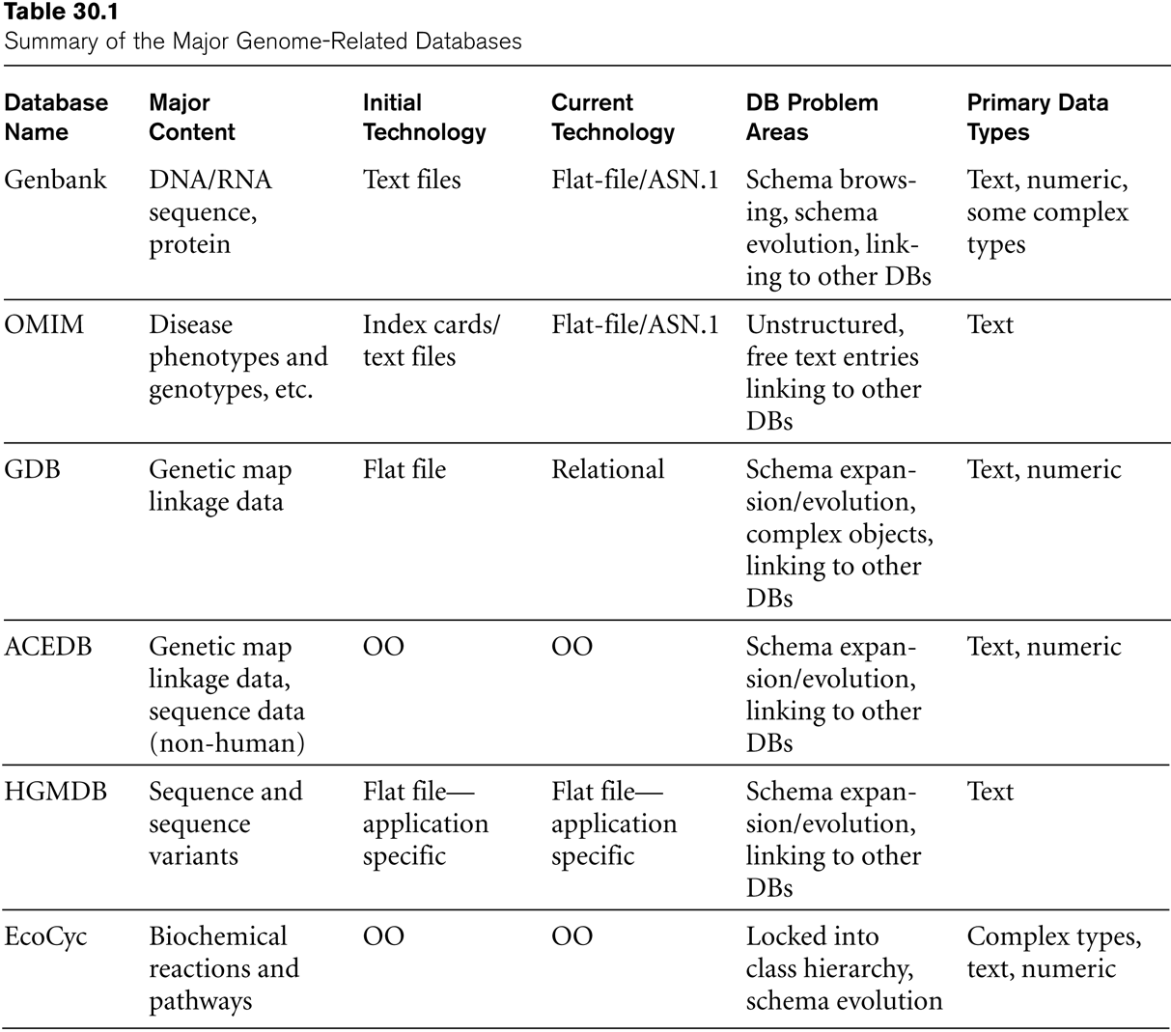
Major Genome-Related Databases

Slide 56
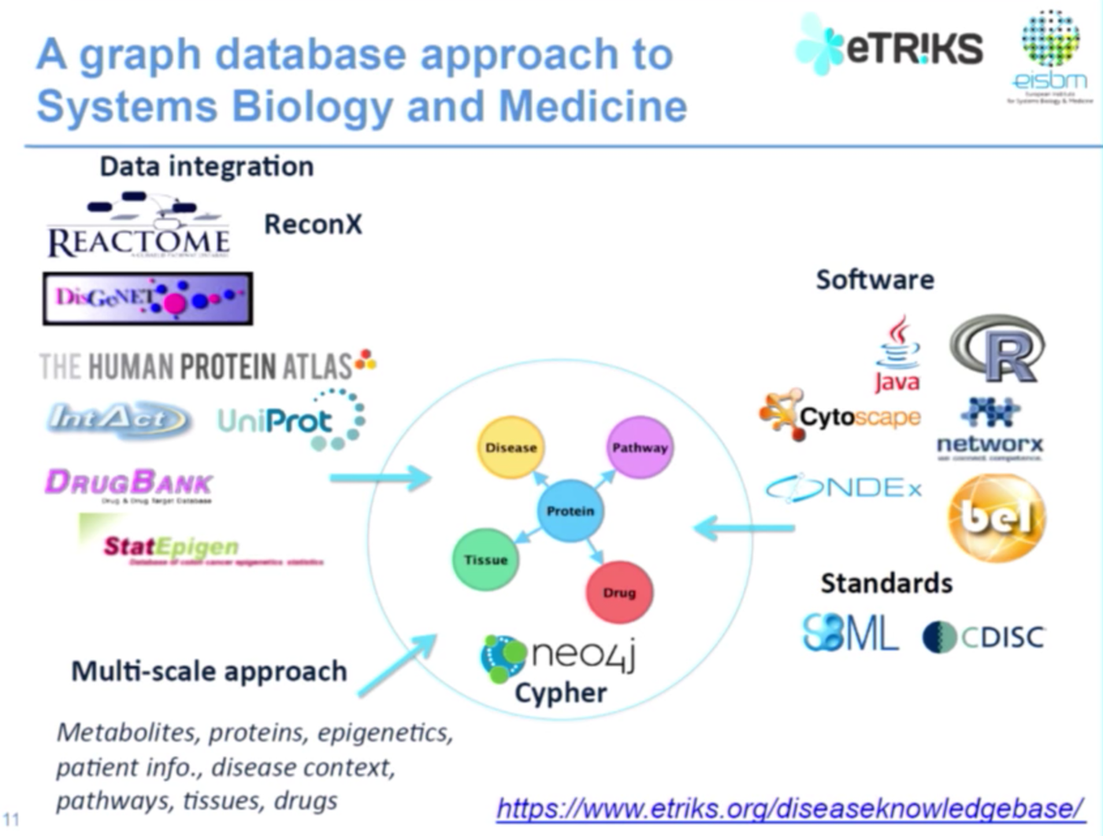

Slide 57
Data Mining and Data Warehousing its Application

Slide 58
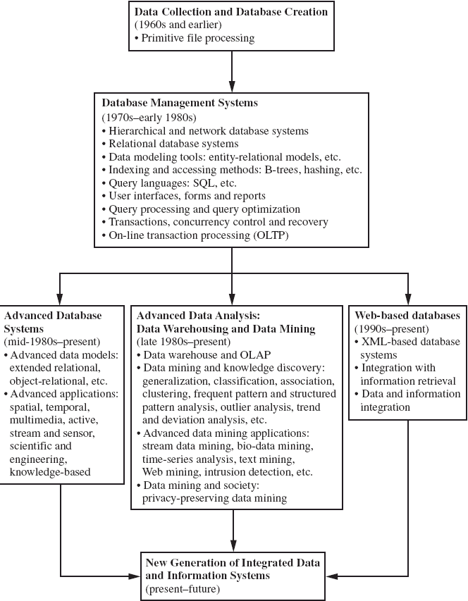
Evolution of Database Technology

Slide 59
Why Data Mining?
The Explosive Growth of Data: from terabytes(1000⁴) to yottabytes(1000⁸)
Data collection and data availability
Automated data collection tools, database systems, web
Major sources of abundant data
Business: Web, e-commerce, transactions, stocks, …
Science: bioinformatics, scientific simulation, medical research …
Society and everyone: news, digital cameras, …
Data rich but information poor!
What does those data mean?
How to analyze data?
Data mining — Automated analysis of massive data sets

Slide 60
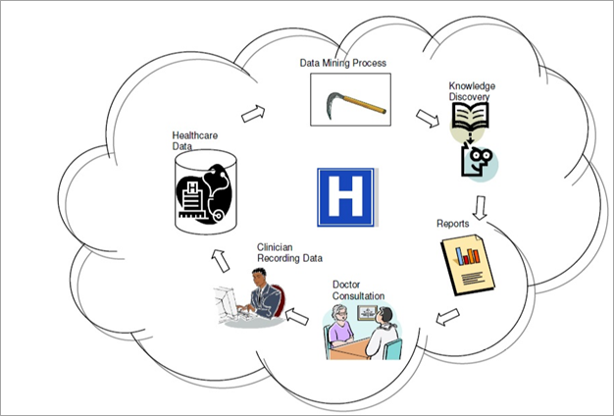
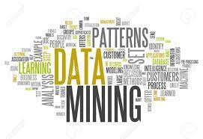
What Is Data Mining?
Data mining (knowledge discovery from data)
Extraction of interesting (non-trivial, implicit, previously unknown and potentially useful) patterns or knowledge from huge amount of data
Alternative names
Knowledge discovery (mining) in databases (KDD), knowledge
extraction, data/pattern analysis, data archeology, data dredging, information harvesting, business intelligence, etc.

Slide 61
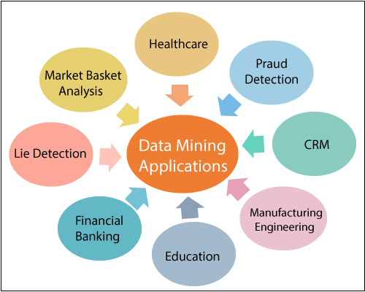
Applications of Data Mining

Slide 62
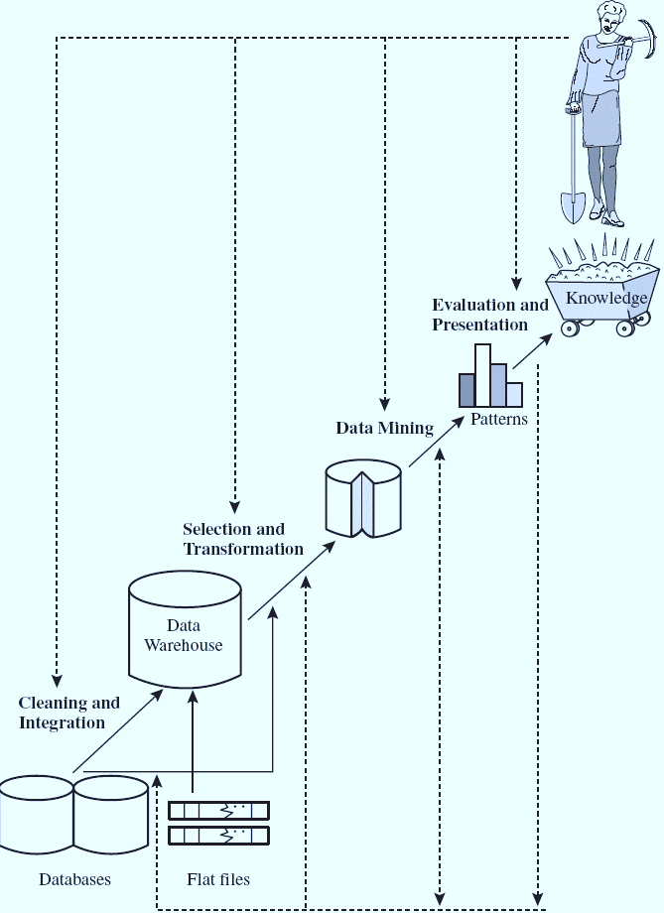
Knowledge Discovery (KDD) Process

Slide 63
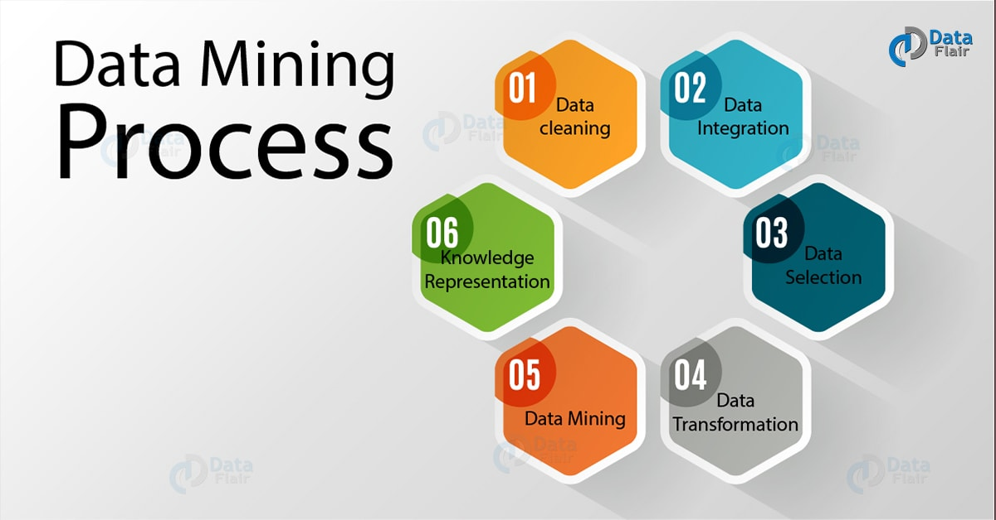
KDD Process: Several Key Steps
Learning the application domain
relevant prior knowledge and goals of application
Identifying a target data set: data selection
Data processing
Data cleaning (remove noise and inconsistent data)
Data integration (multiple data sources maybe combined)
Data selection (data relevant to the analysis task are retrieved from database)
Data transformation (data transformed or consolidated into forms appropriate for mining)
(Done with data preprocessing)
Data mining (an essential process where intelligent methods are applied to extract
data patterns)
Pattern evaluation (indentify the truly interesting patterns)
Knowledge presentation (mined knowledge is presented to the user with
visualization or representation techniques)
Use of discovered knowledge

Slide 64
Goals of Data Mining and Knowledge Discovery
Prediction:
Determine how certain attributes will behave in the future.
Identification:
Identify the existence of an item, event, or activity.
Classification:
Partition data into classes or categories.
Optimization:
Optimize the use of limited resources.

Slide 65
Types of Discovered Knowledge
Association Rules
Classification Hierarchies
Sequential Patterns
Patterns Within Time Series
Clustering

Slide 66
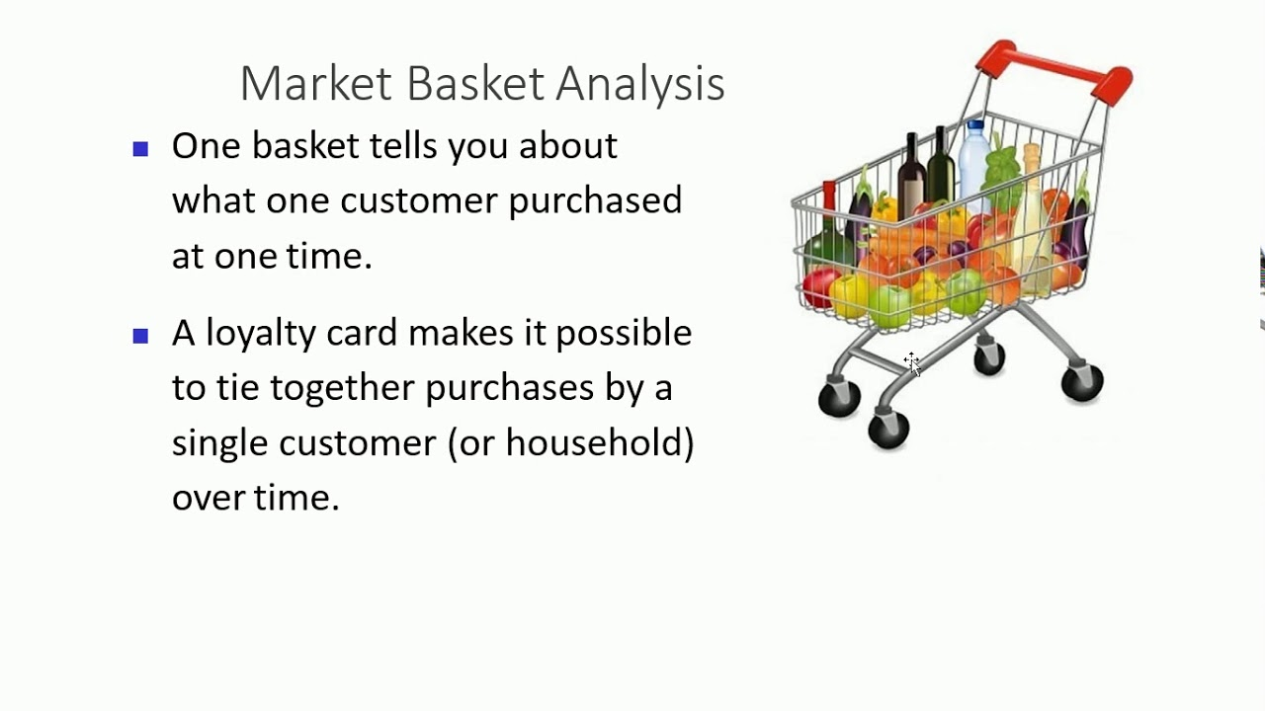
Association Rules
Association rules are frequently used to generate rules from market-basket data.
A market basket corresponds to the sets of items a consumer purchases during one visit to a supermarket.
The set of items purchased by customers is known as an itemset.
An association rule is of the form X=>Y, where X ={x₁, x₂, …., x_{n} }, and Y = {y₁,y₂, …., y_{n}} are sets of items, with x_{i} and y_{i} being distinct items for all i and all j.
For an association rule to be of interest, it must satisfy a minimum support and confidence.

Slide 67
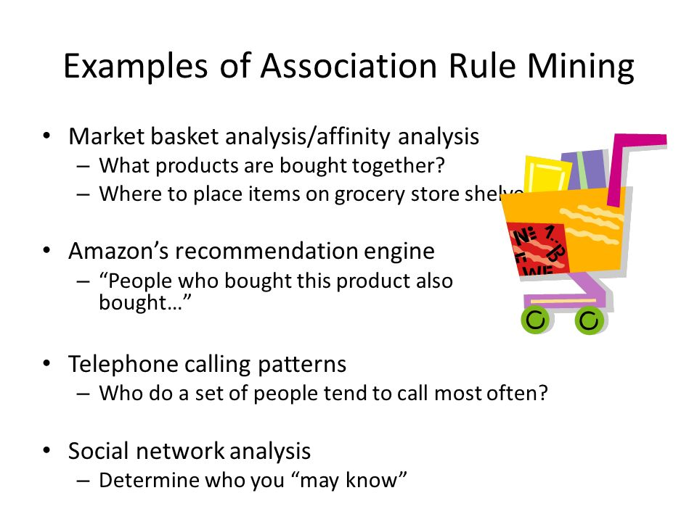
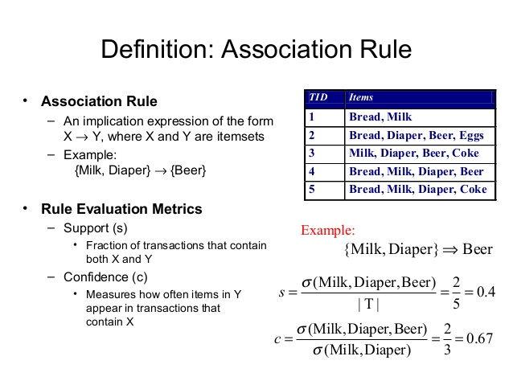
The Apriori algorithm was the first algorithm used to generate association rules.
The Apriori algorithm uses the general algorithm for creating association rules together with downward closure and anti-monotonicity.

Slide 68
Classification
Classification is the process of learning a model that is able to describe different classes of data.
Learning is supervised as the classes to be learned are predetermined.
Learning is accomplished by using a training set of pre-classified data.
The model produced is usually in the form of a decision tree or a set of rules.

Slide 69
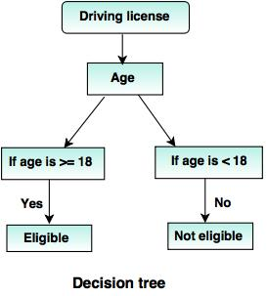
Decision Tree Classifier
Here is one of the rules extracted from the decision tree
IF Age is > = 18 THEN class is “Yes” and Eligible
IF Age < 18 THEN class is “No” and Not Eligible

Slide 70
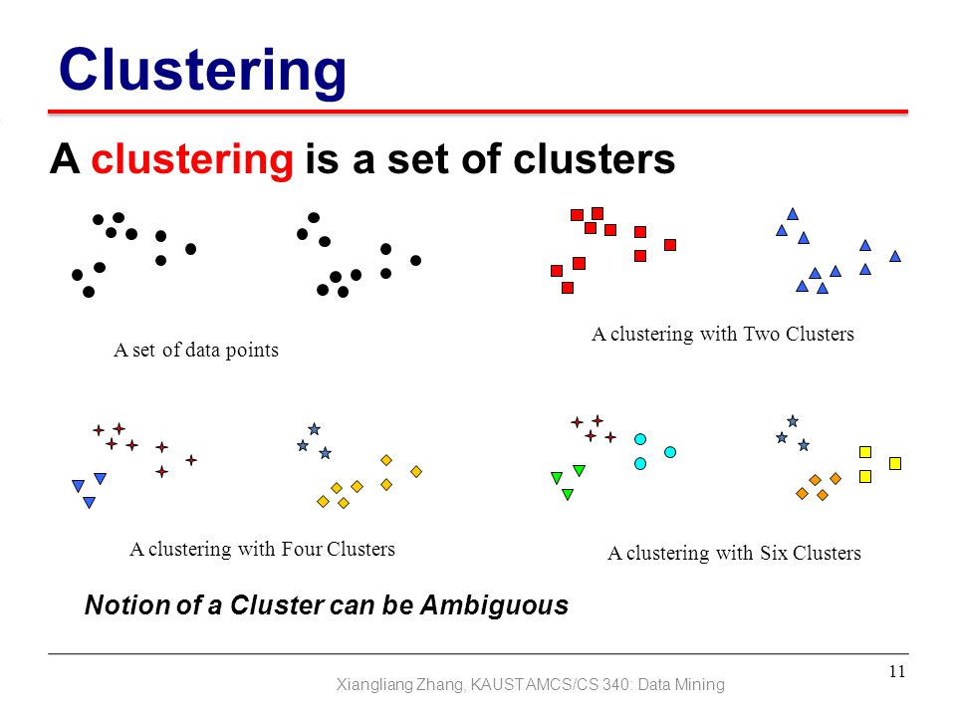
Clustering
Unsupervised learning or clustering builds models from data without predefined classes.
The goal is to place records into groups where the records in a group are highly similar to each other and dissimilar to records in other groups.
The k-Means algorithm is a simple yet effective clustering technique.

Slide 71
Additional Data Mining Methods
Sequential pattern analysis
Time Series Analysis
Regression
Neural Networks
Genetic Algorithms

Slide 72
Sequential Pattern Analysis
Transactions ordered by time of purchase form a sequence of itemsets.
The problem is to find all subsequences from a given set of sequences that have a minimum support.
The sequence S₁, S₂, S₃, .. is a predictor of the fact that a customer purchasing itemset S₁ is likely to buy S₂ , and then S₃, and so on.

Slide 73
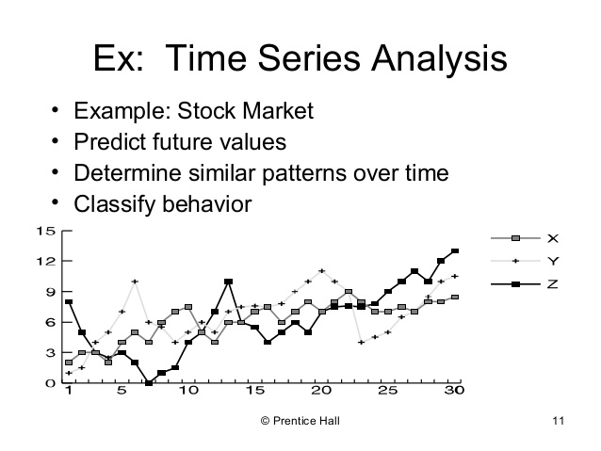
Time Series Analysis
Time series are sequences of events. For example, the closing price of a stock is an event that occurs each day of the week.
Time series analysis can be used to identify the price trends of a stock or mutual fund.
Time series analysis is an extended functionality of temporal data management.

Slide 74
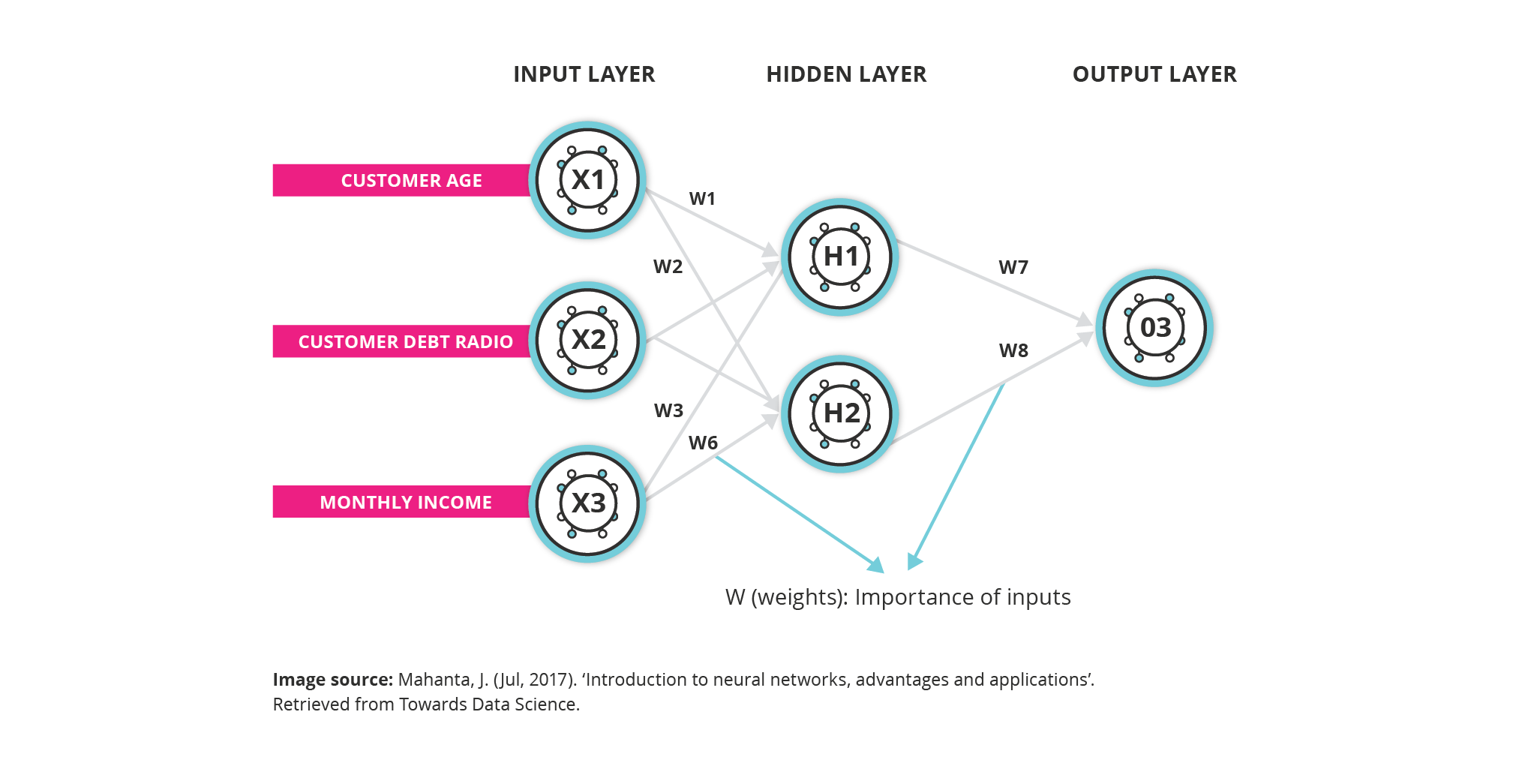
Neural Networks
A neural network is a set of interconnected nodes designed to imitate the functioning of the brain.
Node connections have weights which are modified during the learning process.
Neural networks can be used for supervised learning and unsupervised clustering.
The output of a neural network is quantitative and not easily understood.

Slide 75
Genetic Learning
Genetic learning is based on the theory of evolution.
An initial population of several candidate solutions is provided to the learning model.
A fitness function defines which solutions survive from one generation to the next.
Crossover, mutation and selection are used to create new population elements.

Slide 76
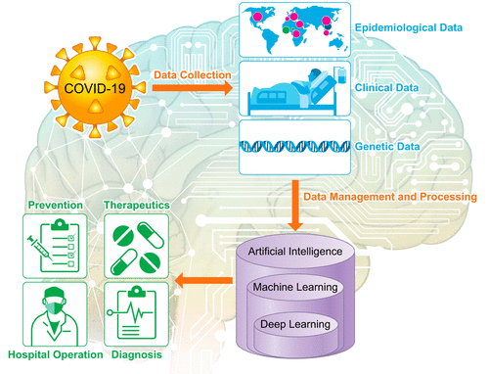

Slide 77
Data Warehouse
Supports information processing by providing a solid platform of consolidated, historical data for analysis.
Designed to get data out and analyze quickly
A data warehouse is:
Subject-oriented : Contains information regarding objects of interest for decision support: Sales by region, by product, etc.
Integrated: Data are typically extracted from multiple, heterogeneous data sources (e.g., from sales, inventory, billing DBs etc.) - ETL (see later).
Time-variant: Contain historical data, longer horizon than operational system.
Non-volatile : Physically separate store, data is not (or rarely) directly updated.

Slide 78
Introduction
Data warehouses have the distinguishing characteristic that they are mainly intended for decision support applications.
Traditional databases are transactional.
Applications that data warehouse supports are:
OLAP (Online Analytical Processing) is a term used to describe the analysis of complex data from the data warehouse.
DSS (Decision Support Systems) also known as EIS (Executive Information Systems) supports organization’s leading decision makers for making complex and important decisions.
Data Mining is used for knowledge discovery, the process of searching data for unanticipated new knowledge.

Slide 79
Data Warehouse vs OLTP

Slide 80
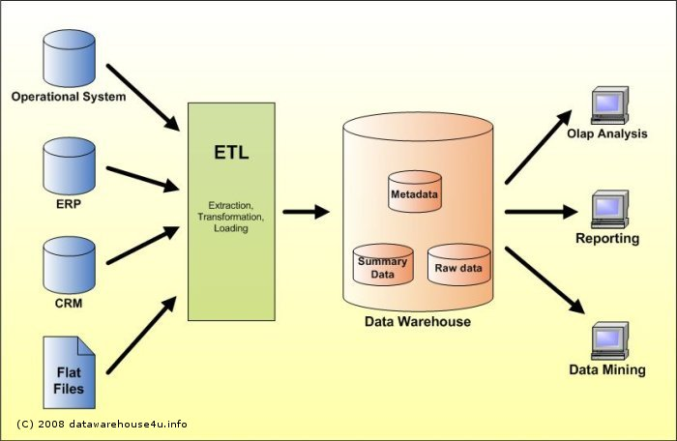
Data Warehouse processing involves
Cleaning and reformatting of data
OLAP
Data Mining

Slide 81
Characteristics of Data Warehouses
Multidimensional conceptual view
Generic dimensionality
Unlimited dimensions and aggregation levels
Unrestricted cross-dimensional operations
Dynamic sparse matrix handling
Client-server architecture
Multi-user support
Accessibility
Transparency
Intuitive data manipulation
Consistent reporting performance
Flexible reporting

Slide 82
Classification of Data Warehouses
Generally, Data Warehouses are an order of magnitude larger than the source databases.
The sheer volume of data is an issue, based on which Data Warehouses could be classified as follows.
Enterprise-wide data warehouses
They are huge projects requiring massive investment of time and resources.
Virtual data warehouses
They provide views of operational databases that are materialized for efficient access.
Data marts
These are generally targeted to a subset of organization, such as a department, and are more tightly focused.

Slide 83
Multi-Dimensional Data
Measures - numerical data being tracked
Dimensions - business parameters that define a transaction
Example: Analyst may want to view sales data (measure) by geography, by time, and by product (dimensions)
Dimensional modeling is a technique for structuring data around business concepts
ER models describe “entities” and “relationships”
Dimensional models describe “measures” and “dimensions”

Slide 84
Multi-dimensional Schemas
Multi-dimensional schemas are specified using:
Dimension table
It consists of tuples of attributes of the dimension.
Fact table
Each tuple is a recorded fact. This fact contains some measured or observed variable (s) and identifies it with pointers to dimension tables. The fact table contains the data, and the dimensions to identify each tuple in the data.

Slide 85
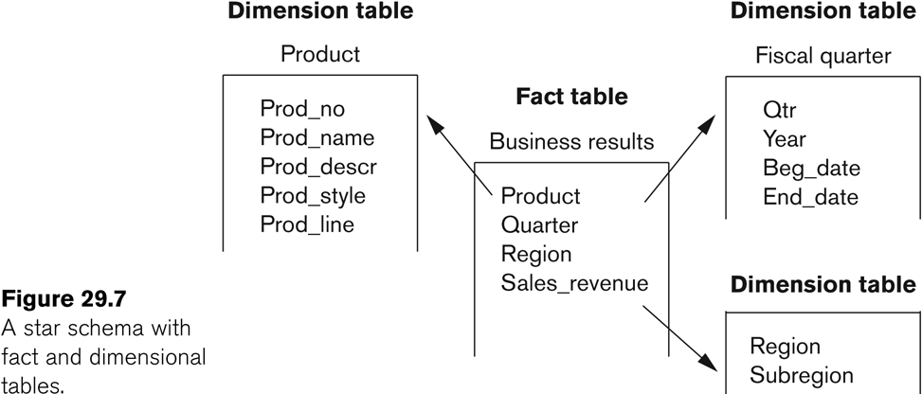
Multi-dimensional Schemas
Two common multi-dimensional schemas are
Star schema:
Consists of a fact table with a single table for each dimension

Slide 86
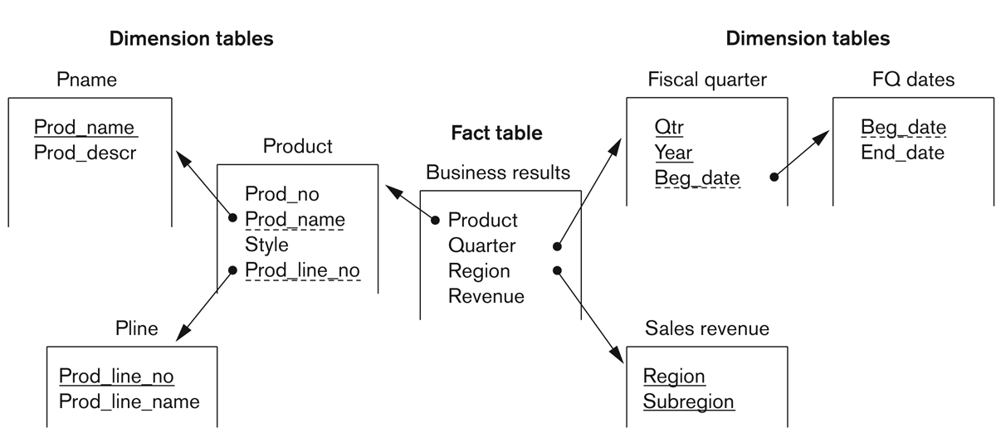
Multi-dimensional Schemas
Snowflake Schema:
It is a variation of star schema, in which the dimensional tables from a star schema are organized into a hierarchy by normalizing them.

Slide 87
Functionality of a Data Warehouse
Functionality that can be expected:
Roll-up: Data is summarized with increasing generalization
Drill-Down: Increasing levels of detail are revealed
Pivot: Cross tabulation is performed
Slice and dice: Performing projection operations on the dimensions.
Sorting: Data is sorted by ordinal value.
Selection: Data is available by value or range.
Derived attributes: Attributes are computed by operations on stored derived values.

Slide 88
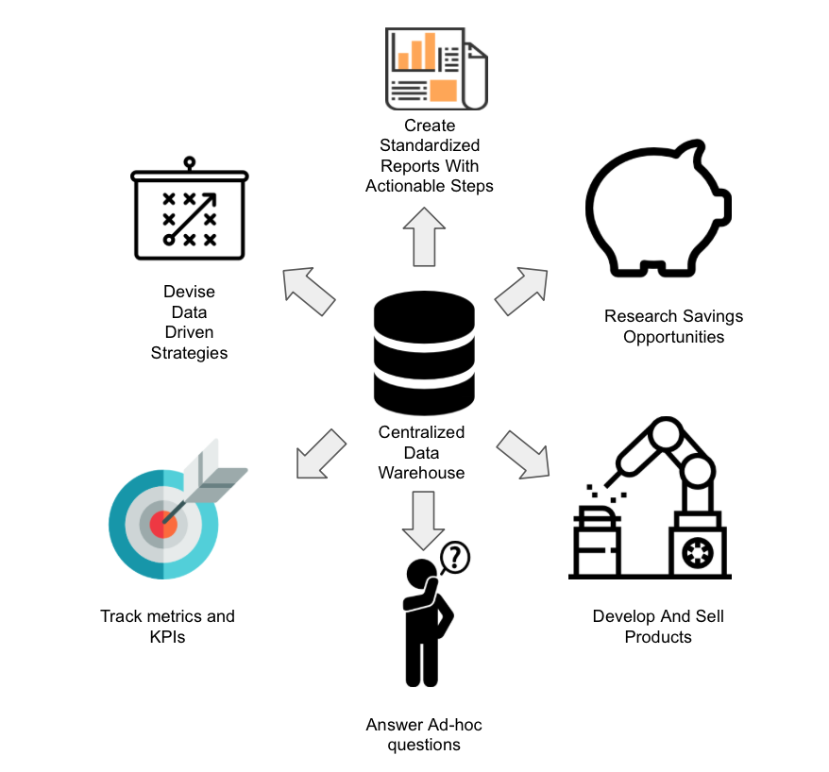
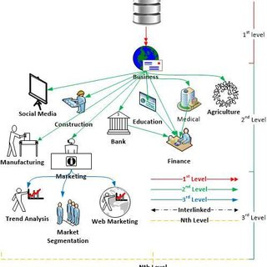
Data Warehouse Applications

Slide 89
THANK YOU
ANY QUERIES ?
Dr.L.LAKSHAMAN
Lakshmanan.cse@sathyabama.ac.in

